Slide 1
Chapter 1
Object-Oriented Programming and Class Hierarchies

Slide 2
Chapter Objectives
Interfaces
Inheritance and code reuse
How Java determines which method to execute when there are multiple methods
Abstract classes
Abstract data types and interfaces
Object class and overriding Object class methods
Exception hierarchy
Checked and unchecked exceptions
Packages and visibility
Class hierarchy for shapes

Slide 3
_ _________ ___ ___ ___
ADTs, Interfaces, and the Java API
Section 1.1

Slide 4
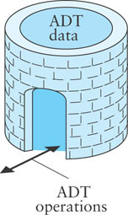
ADTs
Abstract Date Type (ADT)
An encapsulation of data and methods
Allows for reusable code
The user need not know about the implementation of the ADT
A user interacts with the ADT using only public methods

Slide 5
ADTs (cont.)
ADTs facilitate storage, organization, and processing of information
Such ADTs often are called data structures
The Java Collections Framework provides implementations of common data structures

Slide 6
Interfaces
An interface specifies or describes an ADT to the applications programmer:
the methods and the actions that they must perform
what arguments, if any, must be passed to each method
what result the method will return
The interface can be viewed as a contract which guarantees how the ADT will function

Slide 7
Interfaces (cont.)
A class that implements the interface provides code for the ADT
As long as the implementation satisfies the ADT contract, the programmer may implement it as he or she chooses
In addition to implementing all data fields and methods in the interface, the programmer may add:
data fields not in the implementation
methods not in the implementation
constructors (an interface cannot contain constructors because it cannot be instantiated)

Slide 8
Example: ATM Interface
An automated teller machine (ATM) enables a user to perform certain banking operations from a remote location. It must provide operations to:
verify a user's Personal Identification Number (PIN)
allow the user to choose a particular account
withdraw a specified amount of money
display the result of an operation
display an account balance
A class that implements an ATM must provide a method for each operation

Slide 9
Example: ATM Interface (cont.)
Interface
___
Code
An automated teller machine (ATM) enables a user to perform certain banking operations from a remote location. It must support the following operations:
verify a user's Personal Identification Number (PIN)
allow the user to choose a particular account
Withdraw a specified amount of money
display the result of an operation
display an account balance
public interface ATM {
}

Slide 10
Example: ATM Interface (cont.)
Interface
___
Code
An automated teller machine (ATM) enables a user to perform certain banking operations from a remote location. It must support the following operations:
verify a user's Personal Identification Number (PIN)
allow the user to choose a particular account
withdraw a specified amount of money
display the result of an operation
display an account balance
public interface ATM {
}
The keyword interface in the header indicates that an interface is being declared

Slide 11
Example: ATM Interface (cont.)
Interface
___
Code
An automated teller machine (ATM) enables a user to perform certain banking operations from a remote location. It must support the following operations:
verify a user's Personal Identification Number (PIN)
allow the user to choose a particular account
withdraw a specified amount of money
display the result of an operation
display an account balance
public interface ATM {
/** Verifies a user's PIN.
@param pin The user's PIN
*/
boolean verifyPIN(String pin);
}

Slide 12
Example: ATM Interface (cont.)
Interface
___
Code
An automated teller machine (ATM) enables a user to perform certain banking operations from a remote location. It must support the following operations:
verify a user's Personal Identification Number (PIN)
allow the user to choose a particular account
withdraw a specified amount of money
display the result of an operation.
display an account balance
public interface ATM {
/** Verifies a user's PIN.
@param pin The user's PIN
*/
boolean verifyPIN(String pin);
/** Allows the user to select an
account.
@return a String representing the account selected
*/
String selectAccount();
}

Slide 13
Example: ATM Interface (cont.)
Interface
___
Code
An automated teller machine (ATM) enables a user to perform certain banking operations from a remote location. It must support the following operations:
verify a user's Personal Identification Number (PIN)
allow the user to choose a particular account
withdraw a specified amount of money
display the result of an operation.
display an account balance
/** Withdraws a specified amount of money
@param account The account from which the money comes
@param amount The amount of money withdrawn
@return whether or not the operation is successful
*/
boolean withdraw(String account, double amount);
}

Slide 14
Example: ATM Interface (cont.)
Interface
___
Code
An automated teller machine (ATM) enables a user to perform certain banking operations from a remote location. It must support the following operations:
verify a user's Personal Identification Number (PIN)
allow the user to choose a particular account
withdraw a specified amount of money
display the result of an operation
display an account balance
/** Displays the result of an operation
@param account The account from which money was withdrawn
@param amount The amount of money withdrawn
@param success Whether or not the withdrawal took place
*/
void display(String account, double amount, boolean success);

Slide 15
Example: ATM Interface (cont.)
Interface
___
Code
An automated teller machine (ATM) enables a user to perform certain banking operations from a remote location. It must support the following operations:
verify a user's Personal Identification Number (PIN)
allow the user to choose a particular account
withdraw a specified amount of money
display the result of an operation.
display an account balance
/** Displays an account balance
@param account The account selected
*/
void showBalance(String account);

Slide 16
Interfaces (cont.)
The interface definition shows only headings for its methods
Because only headings are shown, they are considered abstract methods
Each abstract method must be defined in a class that implements the interface

Slide 17
Interface Definition
FORM:
public interface interfaceName {
abstract method headings
constant declarations
}
EXAMPLE:
public interface Payable {
public abstract double calcSalary();
public abstract boolean salaried();
public static final double DEDUCTIONS = 25.5;
}
Constants are defined in the interface
DEDUCTIONS are accessible in classes that implement the interface

Slide 18
Interface Definition (cont.)
FORM:
public interface interfaceName {
abstract method headings
constant declarations
}
EXAMPLE:
public interface Payable {
public abstract double calcSalary();
public abstract boolean salaried();
public static final double DEDUCTIONS = 25.5;
}
The keywords public and abstract are implicit in each abstract method definition
And keywords public static final are implicit in each constant declaration
As such, they may be omitted

Slide 19
Interface Definition (cont.)
FORM:
public interface interfaceName {
abstract method headings
constant declarations
}
EXAMPLE:
public interface Payable {
double calcSalary();
boolean salaried();
double DEDUCTIONS = 25.5;
}
The keywords public and abstract are implicit in each abstract method definition
And keywords public static final are implicit in each constant declaration
As such, they may be omitted

Slide 20
The implements Clause
For a class to implement an interface, it must end with the implements clause
public class ATMbankAmerica implements ATM
public class ATMforAllBanks implements ATM
A class may implement more than one interface—their names are separated by commas

Slide 21
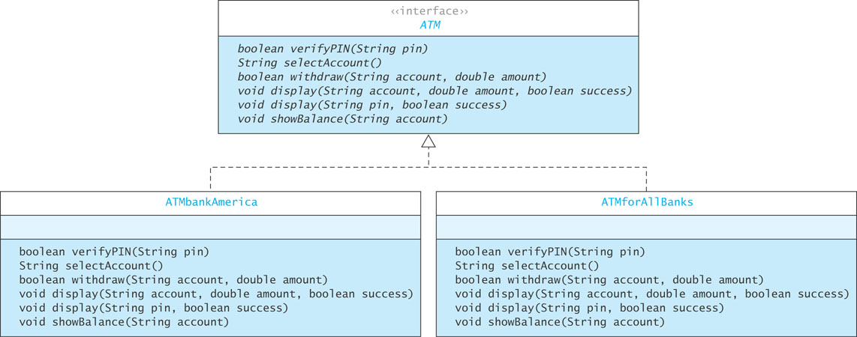
UML Diagram of Interface & Implementers

Slide 22
The implements Clause: Pitfalls
The Java compiler verifies that a class defines all the abstract methods in its interface(s)
A syntax error will occur if a method is not defined or is not defined correctly:
Class ATMforAllBanks should be declared abstract; it does not define method verifyPIN(String) in interface ATM
If a class contains an undefined abstract method, the compiler will require that the class to be declared an abstract class

Slide 23
The implements Clause: Pitfalls (cont.)
You cannot instantiate an interface:
ATM anATM = new ATM(); // invalid statement
Doing so will cause a syntax error:
interface ATM is abstract; cannot be instantiated

Slide 24
Declaring a Variable of an Interface Type
While you cannot instantiate an interface, you can declare a variable that has an interface type
/* expected type */
ATMbankAmerica ATM0 = new ATMBankAmerica();
/* interface type */
ATM ATM1 = new ATMBankAmerica();
ATM ATM2 = new ATMforAllBanks();
The reason for wanting to do this will become clear when we discuss polymorphism

Slide 25
Introduction to Object-Oriented Programming
Section 1.2

Slide 26
Object-Oriented Programming
Object-oriented programming (OOP) is popular because:
it enables reuse of previous code saved as classes
which saves times because previously written code has been tested and debugged already
If a new class is similar to an existing class, the existing class can be extended
This extension of an existing class is called inheritance

Slide 27
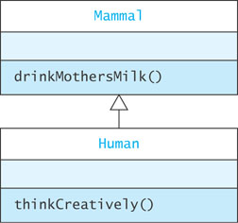
Inheritance
A Human is a Mammal
Human has all the data fields and methods defined by Mammal
Mammal is the superclass of Human
Human is a subclass of Mammal
Human may define other variables and methods that are not contained in Mammal

Slide 28
Inheritance (cont.)
Mammal has only method drinkMothersMilk()
Human has method drinkMothersMilk() and thinkCreatively()
Objects lower in the hierarchy are generally more powerful than their superclasses because of additional attributes

Slide 29

A Superclass and Subclass Example
Computer
A computer has a
manufacturer
processor
RAM
disk

Slide 30
A Superclass and Subclass Example (cont.)
Computer
A computer has
manufacturer
processor
RAM
disk
Computer
String manufacturer
String processor
int ramSize
int diskSize
double processorSpeed

Slide 31
A Superclass and Subclass Example (cont.)
Computer
String manufacturer
String processor
int ramSize
int diskSize
double processorSpeed
int getRamSize()
int getDiskSize()
double getProcessorSpeed()
Double computePower()
String toString()

Slide 32
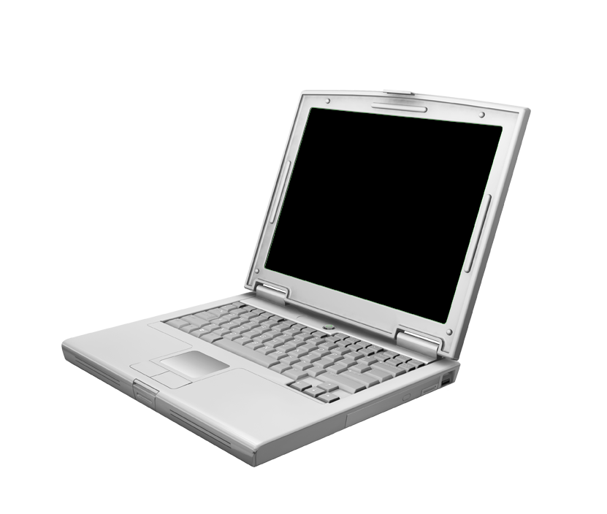
A Superclass and Subclass Example (cont.)
Notebook
A Notebook has all the properties of Computer,
manufacturer
processor
RAM
Disk
plus,
screen size
weight

Slide 33


A Superclass and Subclass Example (cont.)
Computer
String manufacturer
String processor
int ramSize
int diskSize
double processorSpeed
int getRamSize()
int getDiskSize()
double getProcessorSpeed()
Double computePower()
String toString()
Notebook
double screenSize
double weight

Slide 34
A Superclass and Subclass Example (cont.)
The constructor of a subclass begins by initializing the data fields inherited from the superclass(es)
super(man, proc, ram, disk, procSpeed);
which invokes the superclass constructor with the signature
Computer(String man, String processor, double ram, int disk, double procSpeed)

Slide 35
A Superclass and Subclass Example (cont.)
/** Class that represents a computers */
public class Computer {
// Data fields
private String manufacturer;
private String processor;
private double ramSize;
private int diskSize;
private double processorSpeed;
// Methods
/** Initializes a Computer object with all properties specified.
@param man The computer manufacturer
@param processor The processor type
@param ram The RAM size
@param disk The disk size
@param procSpeed The processor speed
*/
public Computer(String man, String processor, double ram, int disk, double procSpeed) {
manufactuer = man;
this.processor = processor;
ramSize = ram;
diskSize = disk;
processorSpeed = procSpeed;
}

Slide 36
A Superclass and Subclass Example (cont.)
Use of this
If you wrote this line as
processor = processor;
you would simply copy the variable processor to itself. To access the field, you need to prefix this:
this.processor = processor;
/** Class that represents a computers */
public class Computer {
// Data fields
private String manufacturer;
private String processor;
private double ramSize;
private int diskSize;
private double processorSpeed;
// Methods
/** Initializes a Computer object with all properties specified.
@param man The computer manufacturer
@param processor The processor type
@param ram The RAM size
@param disk The disk size
@param procSpeed The processor speed
*/
public Computer(String man, String processor, double ram, int disk, double procSpeed) {
manufactuer = man;
this.processor = processor;
ramSize = ram;
diskSize = disk;
processorSpeed = procSpeed;
}

Slide 37
A Superclass and Subclass Example (cont.)
public double computePower() { return ramSize * processorSpeed; }
public double getRamSize() { return ramSize; }
public double getProcessorSpeed() { return processorSpeed; }
public int getDiskSize() { return diskSize; }
// insert other accessor and modifier methods here
public String toString() {
String result = "Manufacturer: " + manufacturer + "\nCPU: " + processor + "\nRAM: " + ramSize + " megabytes" + "\nDisk: " + diskSize + " gigabytes" + "\nProcessor speed: " + processorSpeed + " gigahertz";
return result;
}
}

Slide 38
A Superclass and Subclass Example (cont.)
/** Class that represents a notebook computer */
public class Notebook extends Computer {
// Date fields
private double screenSize;
private double weight;
. . .
}

Slide 39
A Superclass and Subclass Example (cont.)
// methods
//* Initializes a Notebook object with all properties specified.
@param man The computer manufacturer
@param processor The processor type
@param ram The RAM size
@param disk The disk size
@param procSpeed The processor speed
@param screen The screen size
@param wei The weight
*/
public Notebook(String man, String processor, double ram, int disk, double procSpeed, double screen, double wei) {
super(man, proc, ram, disk, procSpeed);
screenSize = screen;
weight = wei;
}

Slide 40
A Superclass and Subclass Example (cont.)
// methods
//* Initializes a Notebook object with all properties specified.
@param man The computer manufacturer
@param processor The processor type
@param ram The RAM size
@param disk The disk size
@param procSpeed The processor speed
@param screen The screen size
@param wei The weight
*/
public Notebook(String man, String processor, double ram, int disk, double procSpeed, double screen, double wei) {
super(man, proc, ram, disk, procSpeed);
screenSize = screen;
weight = wei;
}
super()
super(argumentList)
The super()call in a class constructor invokes the superclass’s constructor that has the corresponding argumentList.
The super() call must be the first statement in a constructor.

Slide 41
The No-Parameter Constructor
If the execution of any constructor in a subclass does not invoke a superclass constructor—an explicit call to super()—Java automatically invokes the no-parameter constructor for the superclass
If no constructors are defined for a class, the no-parameter constructor for that class is provided by default
However, if any constructors are defined, you must explicitly define a no-parameter constructor

Slide 42
Protected Visibility for Superclass Data Fields
Variables with private visibility cannot be accessed by a subclass
Variables with protected visibility (defined by the keyword protected) are accessible by any subclass or any class in the same package
In general, it is better to use private visibility and to restrict access to variables to accessor methods

Slide 43
Is-a versus Has-a Relationships
In an is-a or inheritance relationship, one class is a subclass of the other class
In a has-a or aggregation relationship, one class has the other class as an attribute

Slide 44
Is-a versus Has-a Relationships (cont.)
public class Computer {
private Memory mem;
...
}
public class Memory {
private int size;
private int speed;
private String kind;
...
}
A Computer has only one Memory
But a Computer is not a Memory (i.e. not an is-a relationship)
If a Notebook extends Computer,then the Notebook is-a Computer

Slide 45
_____ _________ _____ __________ ___ ___________
Method Overriding, Method Overloading, and Polymorphism
Section 1.3

Slide 46
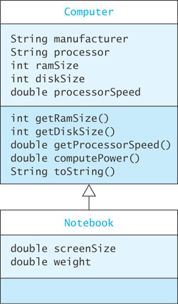
Method Overriding
Continuing the previous example, if we declare and then run:
Computer myComputer = new Computer("Acme", "Intel", 2, 160, 2.4);
Notebook yourComputer = new Notebook("DellGate", "AMD", 4, 240, 1.8, 15.0, 7.5);
System.out.println("My computer is:\n" + myComputer.toString());
System.out.println("Your computer is:\n" + yourComputer.toString());

Slide 47
Method Overriding (cont.)
the output would be:
My Computer is:
Manufacturer: Acme
CPU: Intel
RAM: 2.0 gigabytes
Disk: 160 gigabytes
Speed: 2.4 gigahertz
Your Computer is:
Manufacturer: DellGate
CPU: AMD
RAM: 4.0 gigabytes
Disk: 240 gigabytes
Speed: 1.8 gigahertz
The screensize and weight variables are not printed because Notebook has not defined a toString() method

Slide 48
Method Overriding (cont.)
To define a toString() for Notebook:
public String toString() {
String = result = super.toString() +
"\nScreen size: " +
screenSize + " inches" +
"\nWeight: " + weight +
" pounds";
return result;
}
Now Notebook's toString() method will override Computer's inherited toString()method and will be called for all Notebook objects

Slide 49
Method Overriding (cont.)
To define a toString() for Notebook:
public String toString() {
String = result = super.toString() +
"\nScreen size: " +
screenSize + " inches" +
"\nWeight: " + weight +
" pounds";
return result;
}
Now Notebook's toString() method will override its Computer's toString() and will be called for all Notebook objects.
super.methodName()
Using the prefix super in a call to a method methodName calls the method with that name in the superclass of the current class

Slide 50
Method Overloading (cont.)
Methods in the class hierarchy which have the same name, return type, and parameters override corresponding inherited methods
Methods with the same name but different parameters are overloaded

Slide 51
Method Overloading (cont.)
Take, for example, our Notebook constructor:
public Notebook(String man, String processor, double ram, int disk, double procSpeed, double screen, double wei) {
. . .
}
If we want to have a default manufacturer for a Notebook, we can create a constructor with six parameters instead of seven
public Notebook(String processor, double ram, int disk, double procSpeed, double screen, double wei) {
this(DEFAULT_NB_MAN, double ram, int disk, double procSpeed, double screen, double wei);

Slide 52
Method Overloading (cont.)
Take, for example, our Notebook constructor:
public Notebook(String man, String processor, double ram, int disk, double procSpeed, double screen, double wei) {
. . .
}
If we want to have a default manufacturer for a Notebook, we can create a constructor with six parameters instead of seven
public Notebook(String processor, double ram, int disk, double procSpeed, double screen, double wei) {
this(DEFAULT_NB_MAN, double ram, int disk, double procSpeed, double screen, double wei);
}
This call invokes the seven-parameter constructor passing on the six parameters in this constructor, plus the default manufacturer constant DEFAULT_NB_MAN

Slide 53
Method Overloading: Pitfall
When overriding a method, the method must have the same name and the same number and types of parameters in the same order
If not, the method will overload
This error is common; the annotation @Override preceding an overridden method will signal the complier to issue an error if it does not find a corresponding method to override
@Override
public String toString() {
. . .
}
It is good programming practice to use the @Override annotation in your code

Slide 54
Polymorphism
Polymorphism means having many shapes
Polymorphism is a central feature of OOP
It enables the JVM to determine at run time which of the classes in a hierarchy is referenced by a superclass variable or parameter

Slide 55
Polymorphism (cont.)
For example, if you write a program to reference computers, you may want a variable to reference a Computer or a Notebook
If you declare the reference variable as
Computer theComputer; it can reference either a Computer or a Notebook—because a Notebook is-a Computer

Slide 56
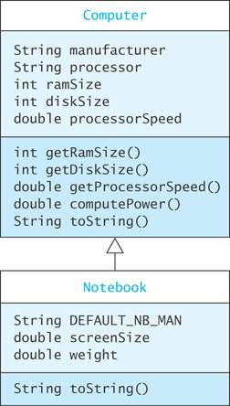
Polymorphism (cont.)
Suppose the following statements are executed:
theComputer = new Notebook("Bravo", "Intel", 4, 240, 2/4, 15.07.5);
System.out.println(theComputer.toString());
The variable theComputer is of type Computer,
Which toString() method will be called, Computer's or Notebook's?

Slide 57
Polymorphism (cont.)
The JVM correctly identifies the type of theComputer as Notebook and calls the toString() method associated with Notebook
This is an example of polymorphism
The type cannot be determined at compile time, but it can be determined at run time

Slide 58
Methods with Class Parameters
Polymorphism simplifies programming when writing methods with class parameters
If we want to compare the power of two computers (either Computers or Notebooks) we do not need to overload methods with parameters for two Computers, or two Notebooks, or a Computer and a Notebook
We simply write one method with two parameters of type Computer and allow the JVM, using polymorphism, to call the correct method

Slide 59
Methods with Class Parameters (cont.)
/** Compares power of this computer and its argument computer
@param aComputer The computer being compared to this computer
@return -1 if this computer has less power,
0 if the same, and
+1 if this computer has more power.
*/
public int comparePower(Computer aComputer) {
if (this.computePower() < aComputer.computePower())
return -1;
else if (this.computePower() == aComputer.computePower())
return 0;
else return 1;
}

Slide 60
Abstract Classes
Section 1.4

Slide 61
Abstract Classes
An abstract class is denoted by using the word abstract in its heading:
visibility abstract class className
An abstract class differs from an actual class (sometimes called a concrete class) in two respects:
• An abstract class cannot be instantiated
• An abstract class may declare abstract methods
Just as in an interface, an abstract method is declared through a method heading:
visibility abstract resultType methodName (parameterList);
An actual class that is a subclass of an abstract class must provide an implementation for each abstract method

Slide 62
Abstract Classes (cont.)
Use an abstract class in a class hierarchy when you need a base class for two or more subclasses that share some attributes
You can declare some or all of the attributes and define some or all of the methods that are common to these subclasses
You can also require that the actual subclasses implement certain methods by declaring these methods abstract

Slide 63
Example of an Abstract Class
public abstract class Food {
public final String name;
private double calories;
// Actual methods
public double getCalories () {
return calories;
}
protected Food (String name, double calories) {
this.name = name;
this.calories = calories;
}
// Abstract methods
public abstract double percentProtein();
public abstract double percentFat();
public abstract double percentCarbs();
}

Slide 64
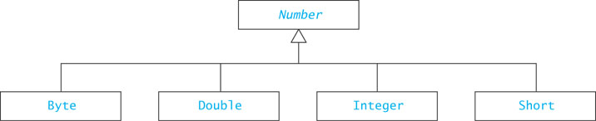
Java Wrapper Classes
A wrapper class is used to store a primitive-type value in an object type
Declares what the (concrete) subclasses have in common

Slide 65
Interfaces, Abstract Classes, and Concrete Classes
A Java interface can declare methods,but cannot implement them
Methods of an interface are called abstract methods.
An abstract class can have:
abstract methods (no body)
concrete methods (with a body)
data fields
Unlike a concrete class, an abstract class
cannot be instantiated
can declare abstract methods which must be implemented in all concrete subclasses

Slide 66
Abstract Classes and Interfaces
Abstract classes and interfaces cannot be instantiated
An abstract class can have constructors!
Purpose: initialize data fields when a subclass object is created
The subclass uses super(…) to call the constructor
An abstract class may implement an interface, but need not define all methods of the interface
Implementation is left to subclasses

Slide 67
Inheriting from Interfaces vs Classes
A class can extend 0 or 1 superclass
An interface cannot extend a class
A class or interface can implement 0 or more interfaces

Slide 68
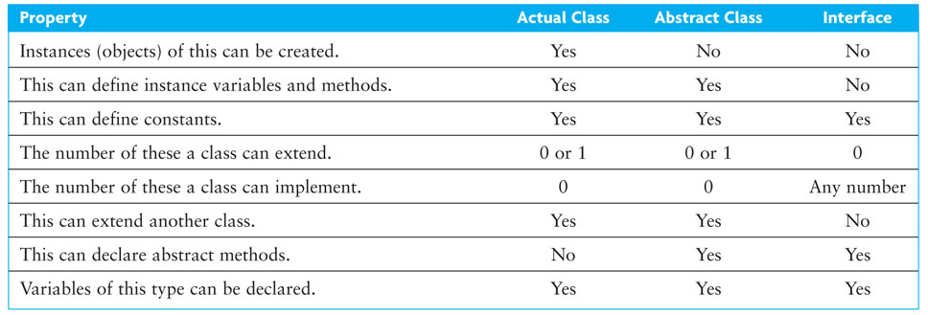
Summary of Features of Actual Classes, Abstract Classes, and Interfaces

Slide 69
Class Object and Casting
Section 1.5

Slide 70
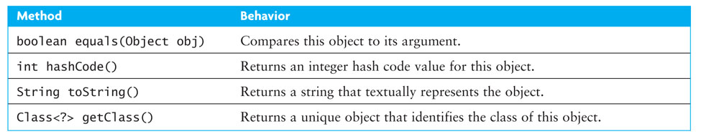
Class Object
Object is the root of the class hierarchy
Every class has Object as a superclass
All classes inherit the methods of Object but may override them

Slide 71
Method toString
You should always override toString method if you want to print object state
If you do not override it:
Object.toString will return a String
Just not the String you want!
Example: ArrayBasedPD@ef08879
The name of the class, @, instance’s hash code

Slide 72
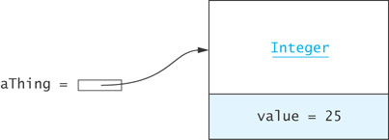
Operations Determined by Type of Reference Variable
As shown previously with Computer and Notebook, a variable can refer to object whose type is a subclass of the variable’s declared type
Java is strongly typed Object athing = new Integer(25);
The compiler always verifies that a variable’s type includes the class of every expression assigned to the variable (e.g., class Object must include class Integer)

Slide 73
Operations Determined by Type of Reference Variable (cont.)
The type of the variable determines what operations are legal
Object athing = new Integer(25);
The following is legal:
athing.toString();
But this is not legal:
athing.intValue();
Object has a toString() method, but it does not have an intValue() method (even though Integer does, the reference is considered of type Object)

Slide 74
Operations Determined by Type of Reference Variable (cont.)
The following method will compile,
athing.equals(new Integer("25"));
Object has an equals method, and so does Integer
Which one is called? Why?
Why does the following generate a syntax error?
Integer aNum = aThing;
Incompatible types!

Slide 75
Casting in a Class Hierarchy
Casting obtains a reference of a different, but matching, type
Casting does not change the object!
It creates an anonymous reference to the object
Integer aNum = (Integer) aThing;
Downcast:
Cast superclass type to subclass type
Java checks at run time to make sure it’s legal
If it’s not legal, it throws ClassCastException

Slide 76
Using instanceof to Guard a Casting Operation
instanceof can guard against a ClassCastException
Object obj = ...;
if (obj instanceof Integer) {
Integer i = (Integer) obj;
int val = i;
...;
} else {
...
}

Slide 77
Polymorphism Eliminates Nested if Statements
Number[] stuff = new Number[10];
// each element of stuff must reference actual
// object which is a subclass of Number
...
// Non OO style:
if (stuff[i] instanceof Integer)
sum += ((Integer) stuff[i]).doubleValue();
else if (stuff[i] instanceof Double)
sum += ((Double) stuff[i]).doubleValue();
...
// OO style:
sum += stuff[i].doubleValue();

Slide 78
Polymorphism Eliminates Nested if Statements (cont.)
Polymorphic code style is more extensible; it works automatically with new subclasses
Polymorphic code is more efficient; the system does one indirect branch versus many tests
So ... uses of instanceof may suggest poor coding style

Slide 79
Method Object.equals
Object.equals method has a parameter of type Object
public boolean equals (Object other) { ... }
Compares two objects to determine if they are equal
A class must override equals in order to support comparison

Slide 80
Employee.equals()
/** Determines whether the current object matches its argument.
@param obj The object to be compared to the current object
@return true if the objects have the same name and address;
otherwise, return false
*/
@Override
public boolean equals(Object obj) {
if (obj == this) return true;
if (obj == null) return false;
if (this.getClass() == obj.getClass()) {
Employee other = (Employee) obj;
return name.equals(other.name) && address.equals(other.address);
} else {
return false;
}
}

Slide 81
Class Class
Every class has a Class object that is created automatically when the class is loaded into an application
Each Class object is unique for the class
Method getClass()is a member of Object that returns a reference to this unique object
In the previous example, if this.getClass() == obj.getClass() is true, then we know that obj and this are both of class Employee

Slide 82
A Java Inheritance Example—The Exception Class Hierarchy
Section 1.6

Slide 83
Run-time Errors or Exceptions
Run-time errors
occur during program execution (i.e. at run-time)
occur when the JVM detects an operation that it knows to be incorrect
cause the JVM to throw an exception
Examples of run-time errors include
division by zero
array index out of bounds
number format error
null pointer exception

Slide 84
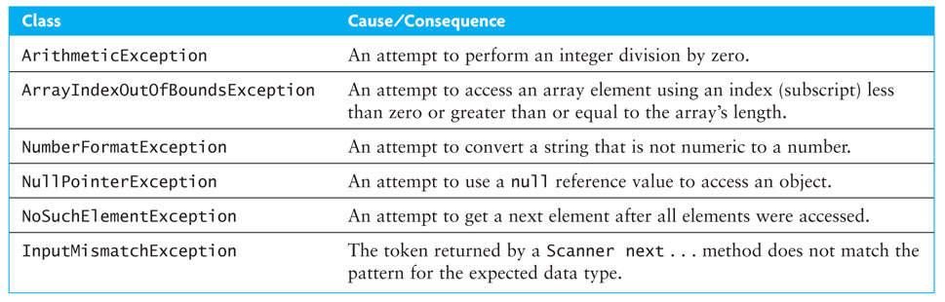
Run-time Errors or Exceptions (cont.)

Slide 85
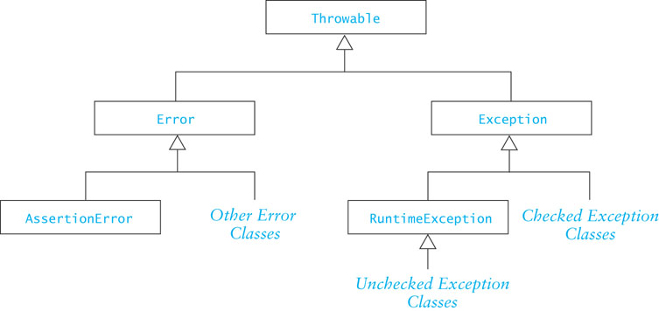
Class Throwable
Throwable is the superclass of all exceptions
All exception classes inherit its methods

Slide 86
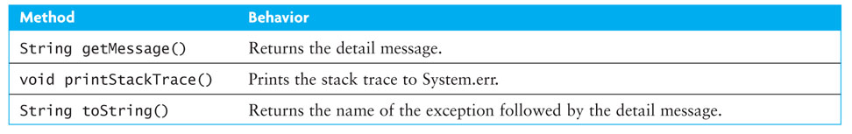
Class Throwable (cont.)
Throwable has several useful methods that are available to all of its subclasses

Slide 87
Checked and Unchecked Exceptions
Checked exceptions
normally not due to programmer error
generally beyond the control of the programmer
all input/output errors are checked exceptions
Examples: IOException, FileNotFoundException
Unchecked exceptions result from
programmer error (try to prevent them with defensive programming).
a serious external condition that is unrecoverable
Examples: NullPointerException, ArrayIndexOutOfBoundsException

Slide 88
Checked and Unchecked Exceptions (cont.)
The class Error and its subclasses represent errors due to serious external conditions; they are unchecked
Example: OutOfMemoryError
You cannot foresee or guard against them
While you can attempt to handle them, it is generally not a good idea as you will probably be unsuccessful
The class Exception and its subclasses can be handled by a program
RuntimeException and its subclasses are unchecked
All others must be either:
explicitly caught or
explicitly mentioned as thrown by the method

Slide 89
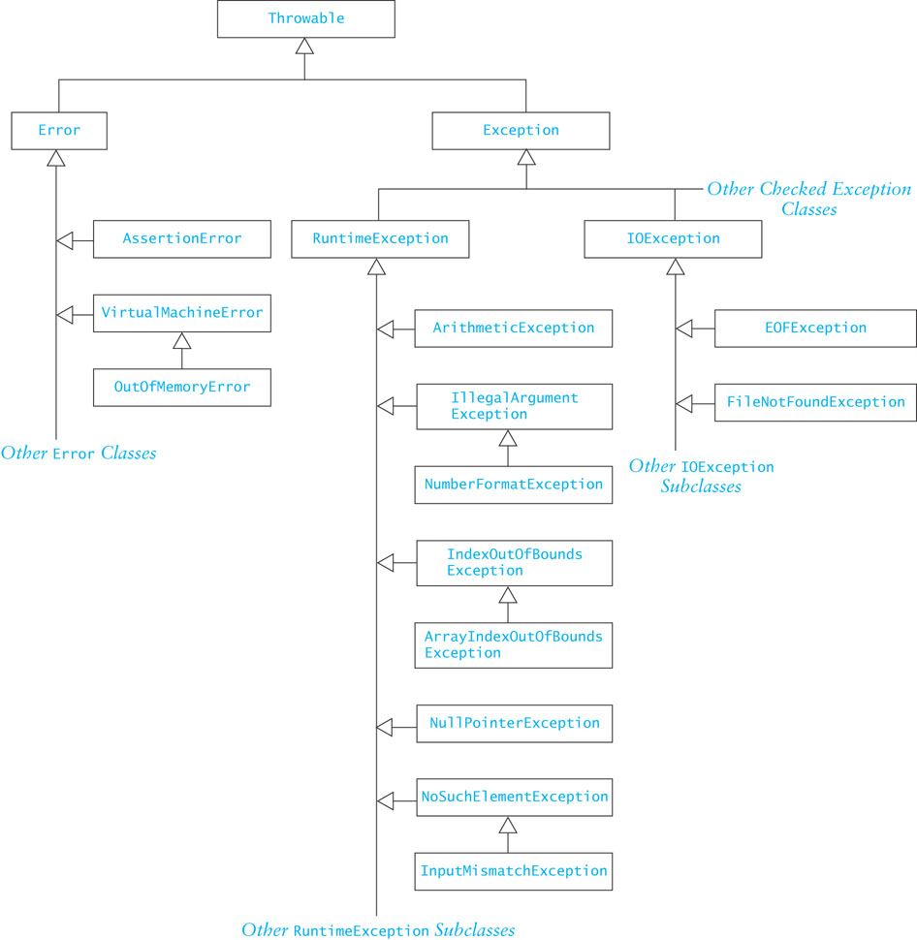
Checked and Unchecked Exceptions (cont.)

Slide 90
Some Common Unchecked Exceptions
ArithmeticException: division by zero, etc.
ArrayIndexOutOfBoundsException
NumberFormatException: converting a “bad” string to a number
NullPointerException
NoSuchElementException: no more tokens available

Slide 91
Handling Exceptions
When an exception is thrown, the normal sequence of execution is interrupted
Default behavior (no handler)
Program stops
JVM displays an error message
The programmer may provide a handle
Enclose statements in a try block
Process the exception in a catch block

Slide 92
The try-catch Sequence
The try-catch sequence resembles an if-then-else statement
try {
// Execute the following statements until an
// exception is thrown
...
// Skip the catch blocks if no exceptions were thrown
} catch (ExceptionTypeA ex) {
// Execute this catch block if an exception of type
// ExceptionTypeA was thrown in the try block
...
} catch (ExceptionTypeB ex) {
// Execute this catch block if an exception of type
// ExceptionTypeB was thrown in the try block
...
}

Slide 93
The try-catch Sequence (cont.)
PITFALL!
Unreachable catch block
ExceptionTypeB cannot be a subclass of ExceptionTypeA. If is was, its exceptions would be caught be the first catch clause and its catch clause would be unreachable.
The try-catch sequence resembles an if-then-else statement
try {
// Execute the following statements until an
// exception is thrown
...
// Skip the catch blocks if no exceptions were thrown
} catch (ExceptionTypeA ex) {
// Execute this catch block if an exception of type
// ExceptionTypeA was thrown in the try block
...
} catch (ExceptionTypeB ex) {
// Execute this catch block if an exception of type
// ExceptionTypeB was thrown in the try block
...
}

Slide 94
Using try-catch
User input is a common source of exceptions
public static int getIntValue(Scanner scan) {
int nextInt = 0; // next int value
boolean validInt = false; // flag for valid input
while(!validInt) {
try {
System.out.println("Enter number of kids: ");
nextInt = scan.nextInt();
validInt = true;
} catch (InputMismatchException ex) {
scan.nextLine(); // clear buffer
System.out.println("Bad data-enter an integer");
}
}
return nextInt;
}

Slide 95
Throwing an Exception When Recovery is Not Obvious
In some cases, you may be able to write code that detects certain types of errors, but there may not be an obvious way to recover from them
In these cases an the exception can be thrown
The calling method receives the thrown exception and must handle it

Slide 96
Throwing an Exception When Recovery is Not Obvious (cont.)
public static void processPositiveInteger(int n) {
if (n < 0) {
throw new IllegalArgumentException( "Invalid negative argument");
} else {
// Process n as required
...
}
}

Slide 97
Throwing an Exception When Recovery is Not Obvious (cont.)
public static void main(String[] args) {
Scanner scan = new Scanner(System.in);
try {
int num = getIntValue(scan);
processPositiveInteger(num);
} catch (IllegalArguementException ex) {
System.err.println(ex.getMessage());
System.exit(1); // error indication
}
System.exit(0); // normal exit
}

Slide 98
Packages and Visibility
Section 1.7

Slide 99
Packages
A Java package is a group of cooperating classes
The Java API is organized as packages
Indicate the package of a class at the top of the file:
package classPackage;
Classes in the same package should be in the same directory (folder)
The folder must have the same name as the package
Classes in the same folder must be
in the same package

Slide 100
Packages and Visibility
Classes not part of a package can only access public members of classes in the package
If a class is not part of the package, it must access the public classes by their complete name, which would be packagename.className
For example,
x = Java.awt.Color.GREEN;
If the package is imported, the packageName prefix is not required.
import java.awt.Color;
...
x = Color.GREEN;

Slide 101
The Default Package
Files which do not specify a package are part of the default package
If you do not declare packages, all of your classes belong to the default package
The default package is intended for use during the early stages of implementation or for small prototypes
When you develop an application, declare its classes to be in the same package

Slide 102
Visibility
You know about three visibility layers, public, protected, private
A fourth layer, package visibility, lies between private and protected
Classes, data fields, and methods with package visibility are accessible to all other methods of the same package, but are not accessible to methods outside the package
Classes, data fields, and methods that are declared protected are visible within subclasses that are declared outside the package (in addition to being visible to all members inside the package)
There is no keyword to indicate package visibility
Package visibility is the default in a package if public, protected, private are not used

Slide 103
Visibility Supports Encapsulation
Visibility rules enforce encapsulation in Java
private: for members that should be invisible even in subclasses
package: shields classes and members from classes outside the package
protected: provides visibility to extenders of classes in the package
public: provides visibility to all

Slide 104
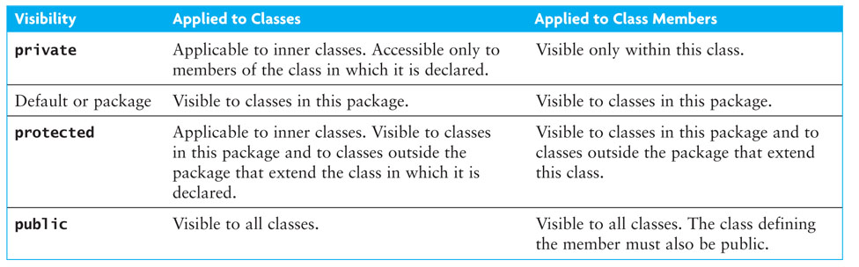
Visibility Supports Encapsulation (cont.)

Slide 105
Visibility Supports Encapsulation (cont.)
Encapsulation insulates against change
Greater visibility means less encapsulation
So… use the most restrictive visibility possible to get the job done!

Slide 106
A Shape Class Hierarchy
1.8

Slide 107
Case Study: Processing Geometric Figures
Problem
We want to process some standard geometric shapes. Each figure object will be one of three standard shapes (rectangle, circle, right triangle). We want do standard computations, such as finding the area and perimeter, for any of these shapes.
Analysis
For each geometric shape, we need a class that represents the shape and knows how to perform the standard computations on it. These classes will be Rectangle, Circle, and RtTriangle. To ensure that these shape classes all define the required computational methods (finding area and perimeter), we will make them abstract methods in the base class (Shape) for the shape hierarchy. If a shape class does not have the required methods, we will get a syntax error when we attempt to compile it.

Slide 108
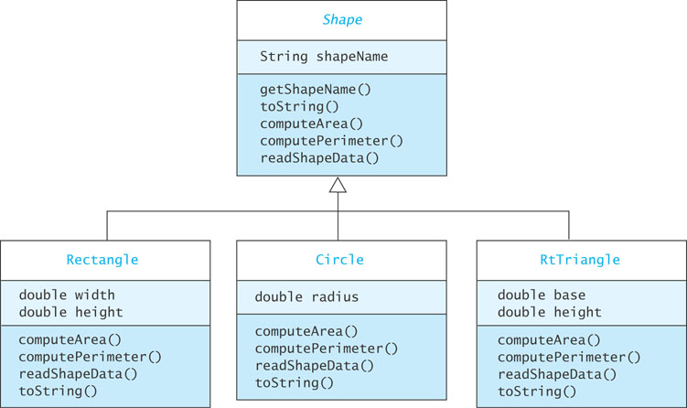
Shape Class Hierarchy

Slide 109
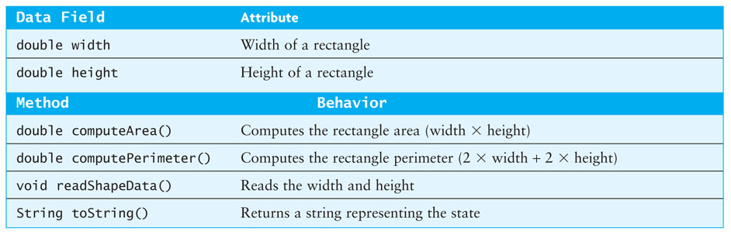
Class Rectangle

